Slide 1

Structured Query Language for Data Management
7
JOINs and SET
9
ADVANCED
5
FROM
How to create…
Backup database
Using cursors
Temporary tables
Variables….
1
DATABASE
3
WHERE
Joining Tables
Using Aliases …
What is a database
What is SQL
How to install SQL Server …
Basics of WHERE
Logical Operations
Using literals
Using Wildcards…
8
INSERT & DELETE
10
WHAT IS NEXT?
Inserting data
Deleting data
Truncate a table..
Where to get help
SQL interview quests
4
GROUP BY & HAVING
6
CREATE & DROP TABLE
Basics of Summarizing
Aggregate functions
Filtering aggregates …
Primary and foreign keys…
2
SELECT & ORDER BY
Basics of SELECT
Math operations
CASE and IIF
*…
Biz Nigatu
Software Engineer and Instructor
reckonedforce.com
@bizNigatu

Slide 2
Section 7 – JOINs and UNION in MS SQL Server
How to use INNER JOIN or simply JOIN?
How to use LEFT OUT JOIN or simply LEFT JOIN?
How to use RIGHT OUT JOIN or simply RIGHT JOIN?
What is FULL OUT JOIN?
What is CROSS OUT JOIN?
How to use Subqueries in FROM clause?
How to join tables using a WHERE clause?
How to use CROSS APPLY in FROM clause?
How to vertically combine data using set operations UNION, INTERSECT and EXCEPT?
Exercise Questions

Slide 3
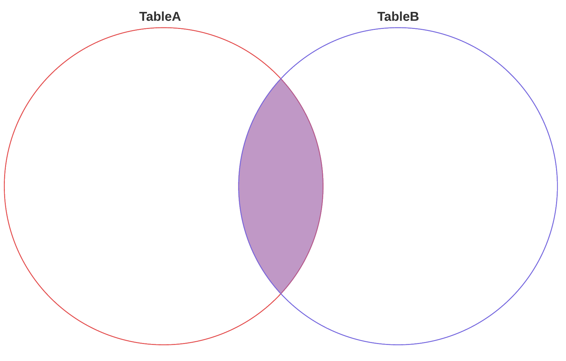
INNER JOIN
Inner join is a join that displays only the rows that have a match in both joined tables.
SELECT *
FROM TableA as A
INNER JOIN TableB as B
on A.ID = B.ID;

Slide 4
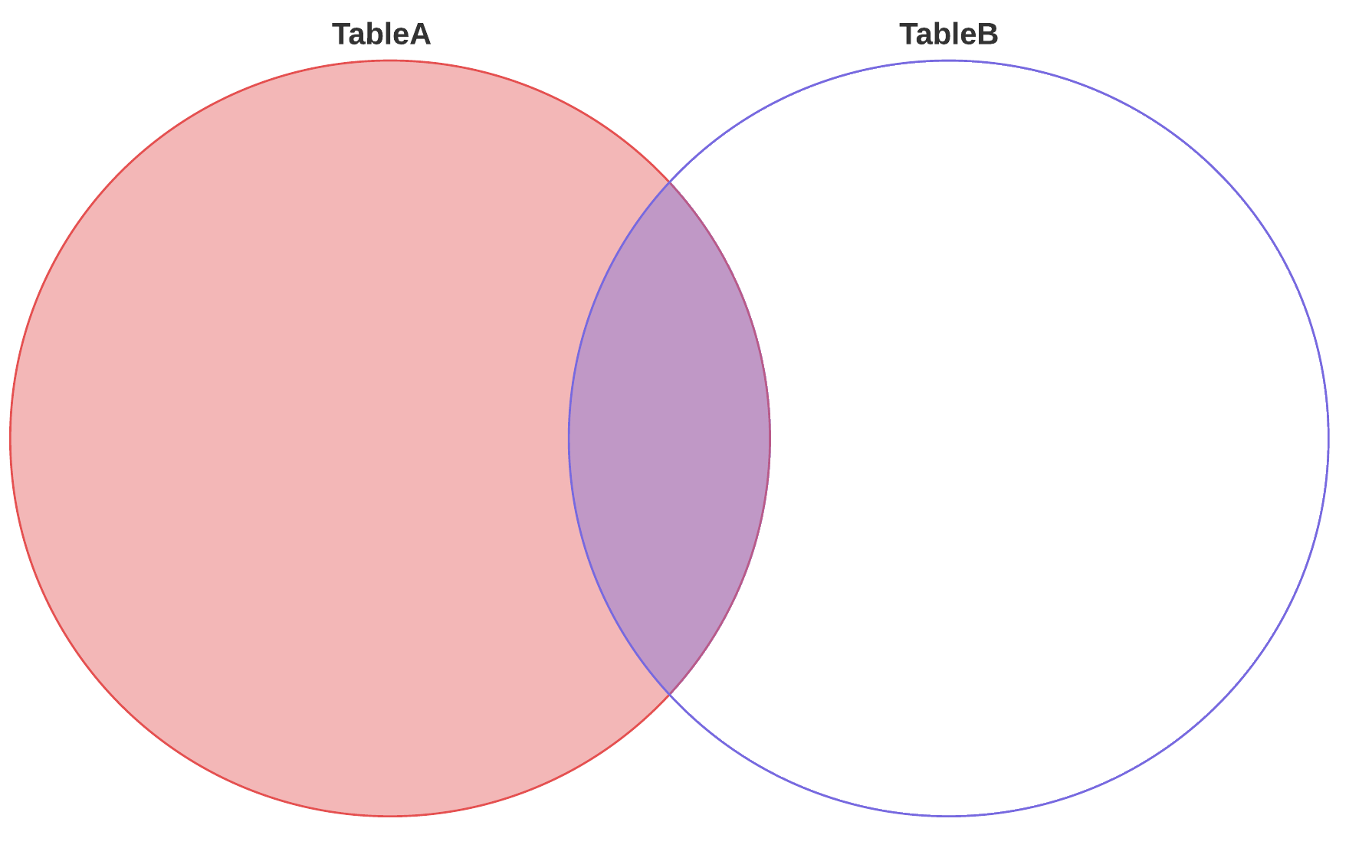
LEFT OUTER JOIN
All rows from the first-named table (the "left" table, which appears leftmost in the JOIN clause) are included.
SELECT *
FROM TableA as A
LEFT JOIN TableB as B
on A.ID = B.ID;

Slide 5
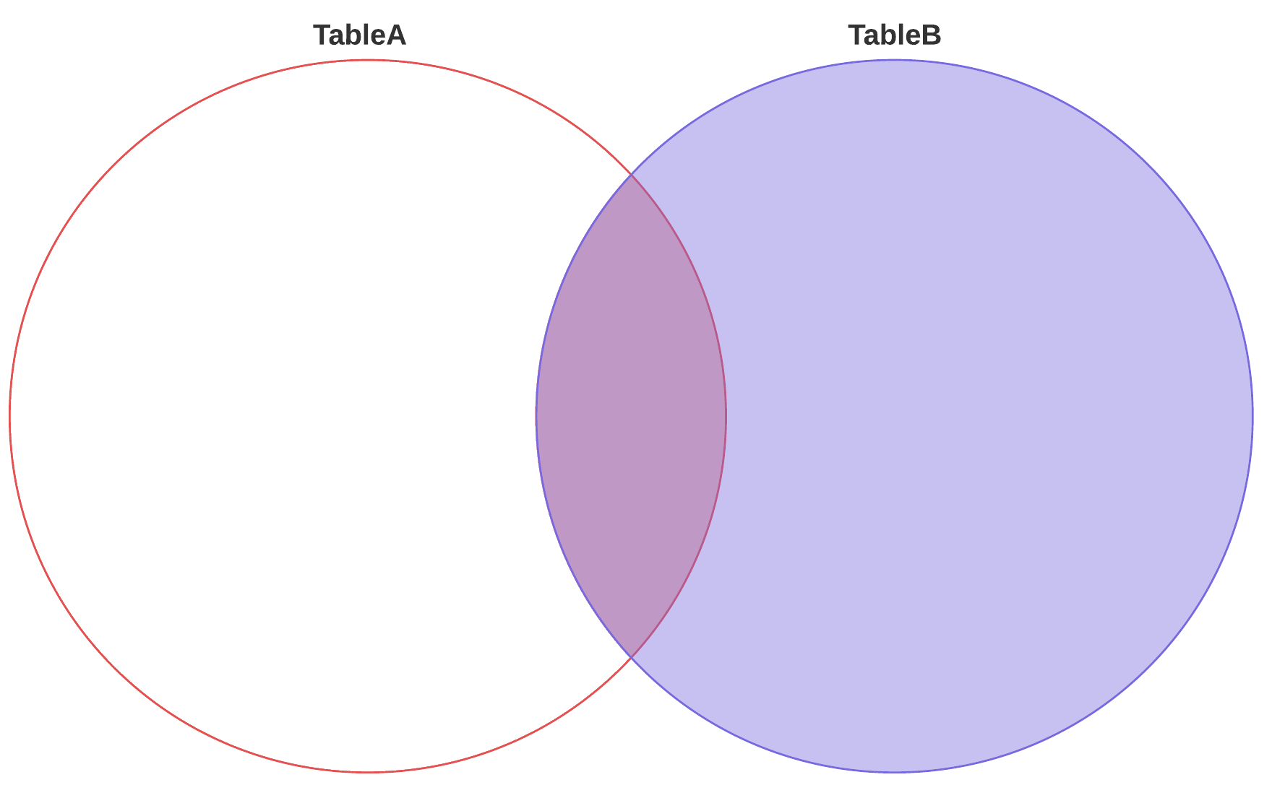
RIGHT OUTER JOIN
All rows in the second-named table (the "right" table, which appears right most in the JOIN clause) are included.
SELECT *
FROM TableA as A
RIGHT JOIN TableB as B
on A.ID = B.ID;

Slide 6
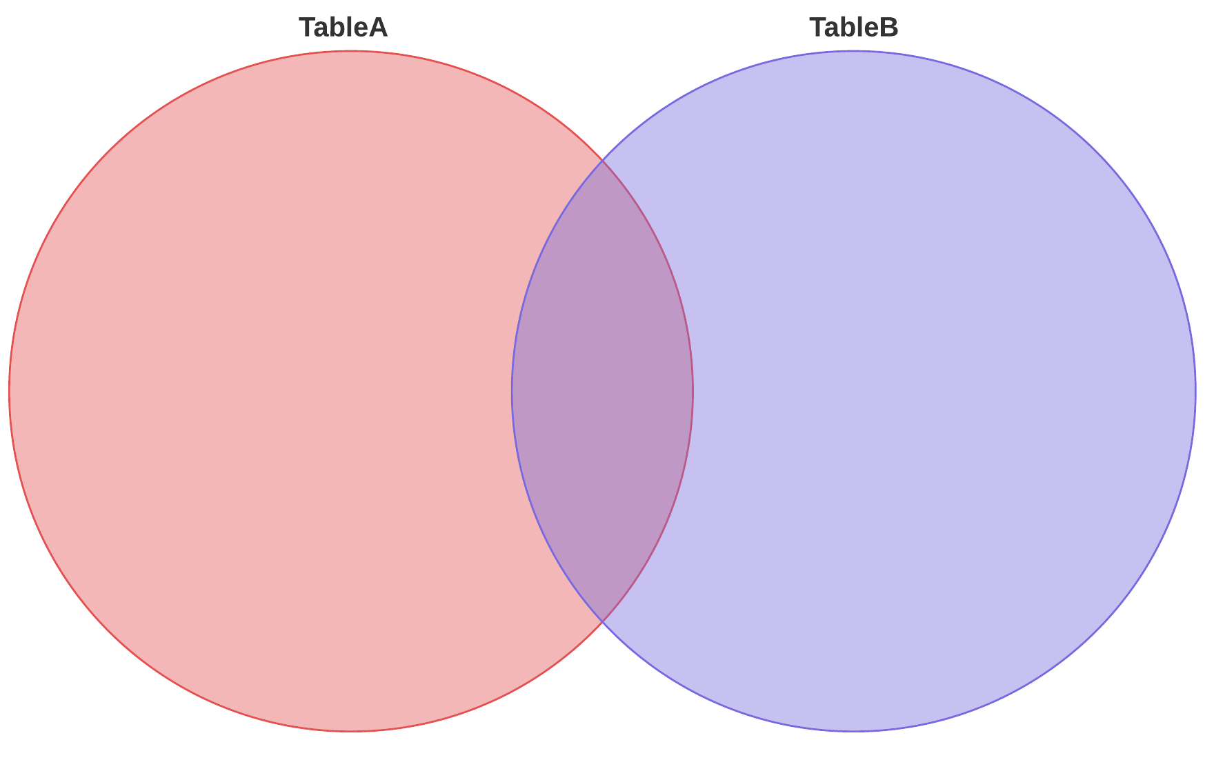
FULL OUTER JOIN
Full outer join All rows in all joined tables are included, whether they are matched or not.
SELECT *
FROM TableA as A
FULL OUTER JOIN TableB as B
on A.ID = B.ID;

Slide 7
Exercise Questions
Find all cities that exist in the continent of Africa?
You are an analyst for Census Bureau and asked to find US cities that are losing their population year after year, for example, Akron Ohio? -- hint use Citypops tables and make sure the cities are in the USA.
You are working as a database consultant to one of the major political party in the next national election. Your party asked you to provide the top 3, most populated cities in the Swing States to run TV ads? -- hint Use City table. Find the Swing States from https://en.wikipedia.org/wiki/Swing_state
You are working for FEMA, and due to its relations to hurricane you are requested to find rivers that have "estuary elevation" more than 100 feet in the USA? -- hint Make sure the estuary is in the USA.
Create a report that has the name of State and all water body sorted by State and Water body in ascending order? -- hint vertically combine [State, Lake] and [State, River]

